Slide 1


Grunttie Donald Anusa
24/02/2026

Slide 2

Outline
Executive Summary
Introduction
Methodology
Results
Conclusion
Appendix

Slide 3
Executive Summary
The objective of this project is to predict whether the Falcon 9 first stage will land successfully. SpaceX can offer launches at roughly 62 million dollars because they reuse the first stage, whereas other providers cost over 165 million dollars. By predicting landing success, we can determine the actual cost of a launch, providing valuable insight for competitors bidding against SpaceX

Slide 4
Introduction
SpaceX advertises Falcon 9 rocket launches on its website with a cost of 62 million dollars while other providers cost upward of 165 million dollars each, much of the savings is because SpaceX can reuse the first stage. Therefore, we will predict if the Falcon 9 first stage wll land successfully. Thus, if we can determine whether the first stage will land, we can also determine the cost of a launch.Hence this information can be used if an alternate company wants to bid against SpaceX for a rocket launch.

Slide 5

Section 1

Slide 6
Methodology
Executive Summary
Data collection methodology:
Describe how data was collected
Perform data wrangling
Describe how data was processed
Perform exploratory data analysis (EDA) using visualization and SQL
Perform interactive visual analytics using Folium and Plotly Dash
Perform predictive analysis using classification models
How to build, tune, evaluate classification models

Slide 7
Data Collection
The data collection process used SpaceX REST API endpoints to access launch data. Followed by this was the HTTP GET request to retrieve data in JSON format and then parsed and normalized nested JSON responses into Pandas dataframe. I then filtered records to include only Falcon 9 launches and integrated additional data (rockets, payloads, cores) via ID-based REST calls. Lastly, the dataset was cleaned and prepared for downstream analysis.

Slide 8
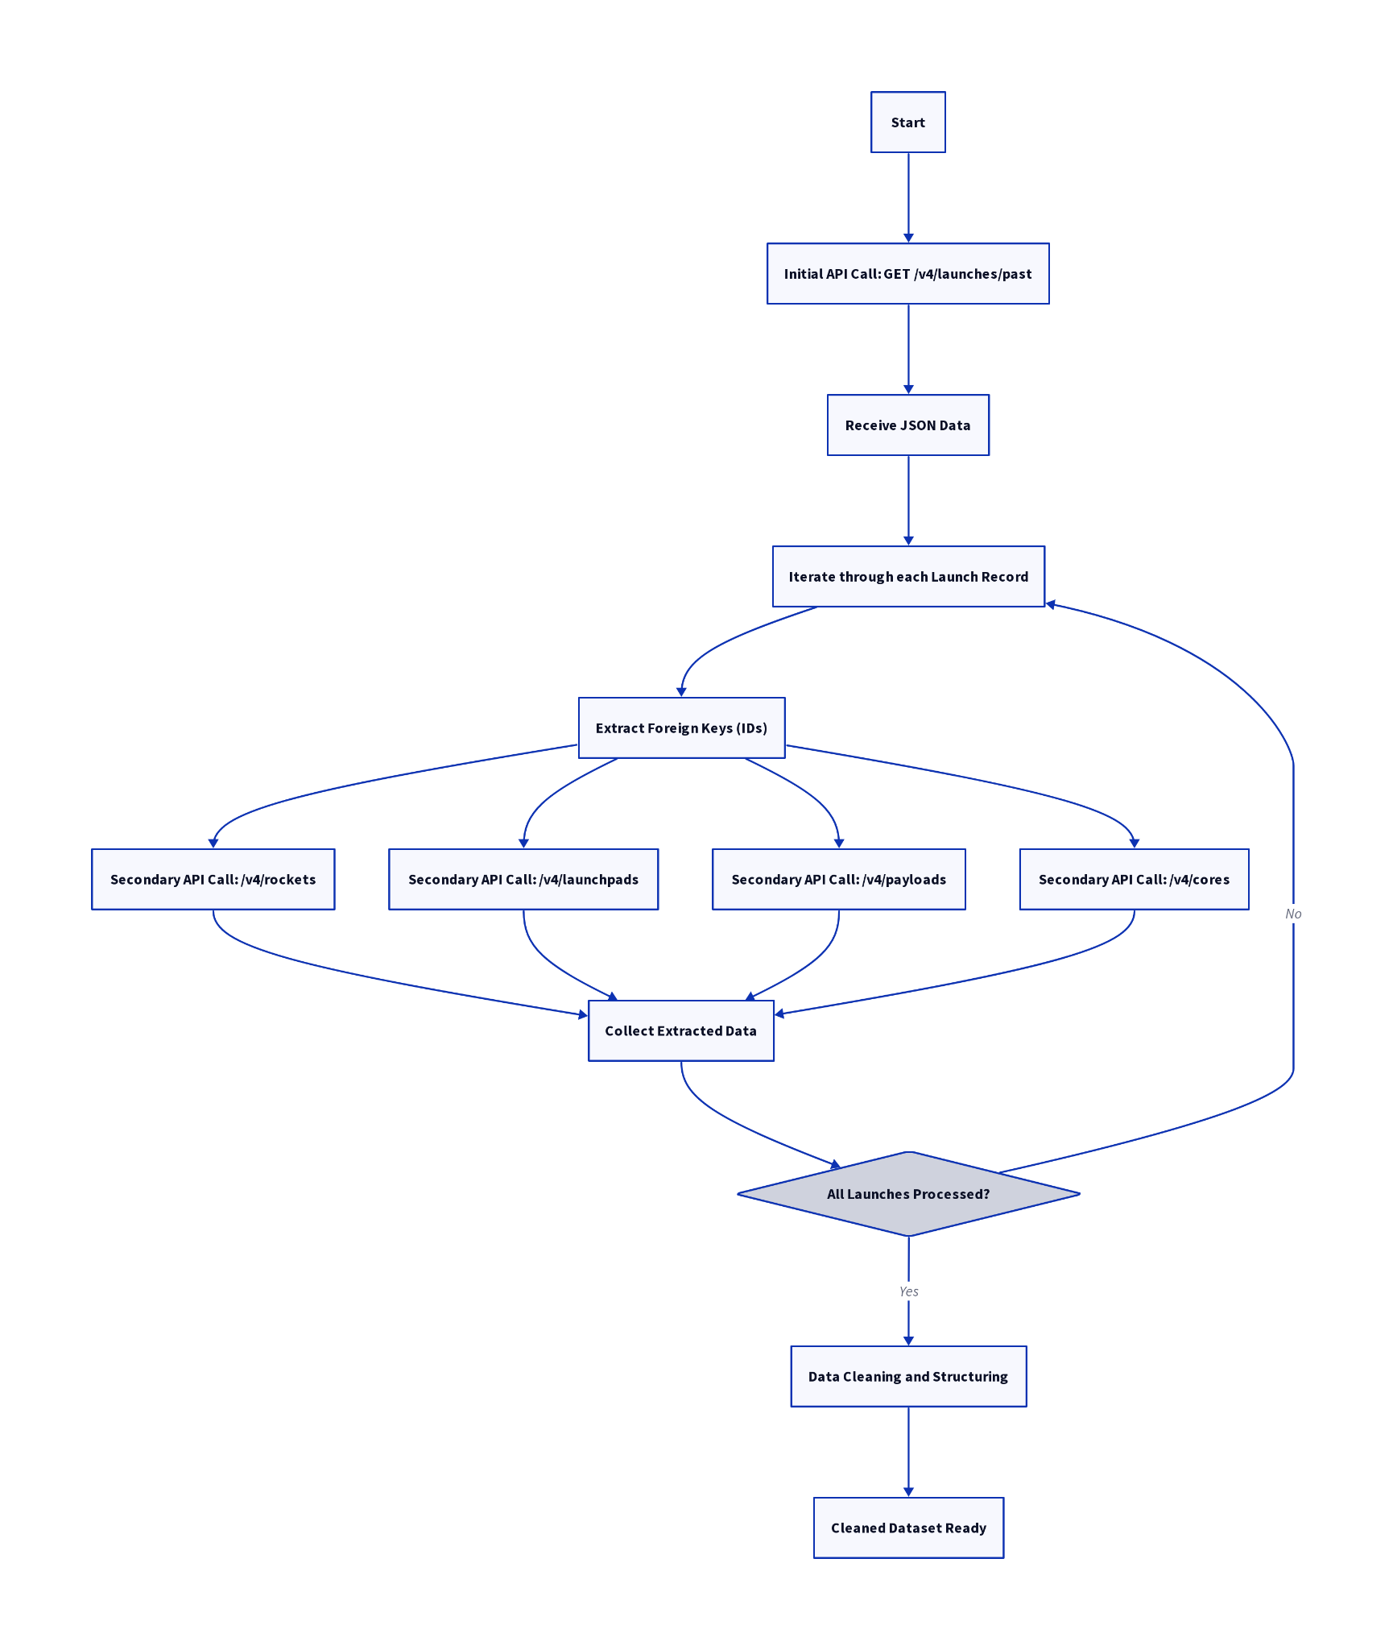
Data Collection – SpaceX API
key phrases
SpaceX REST API, Get Request,
primary endpoint, data enrichment, secondary API calls, foreign key iteration, JSON data processing, data normalization.
https://github.com/Anusa123/Data-Science-Projects/blob/main/Capstone%20Projects/jupyter-labs-spacex-data-collection-api.ipynb

Slide 9
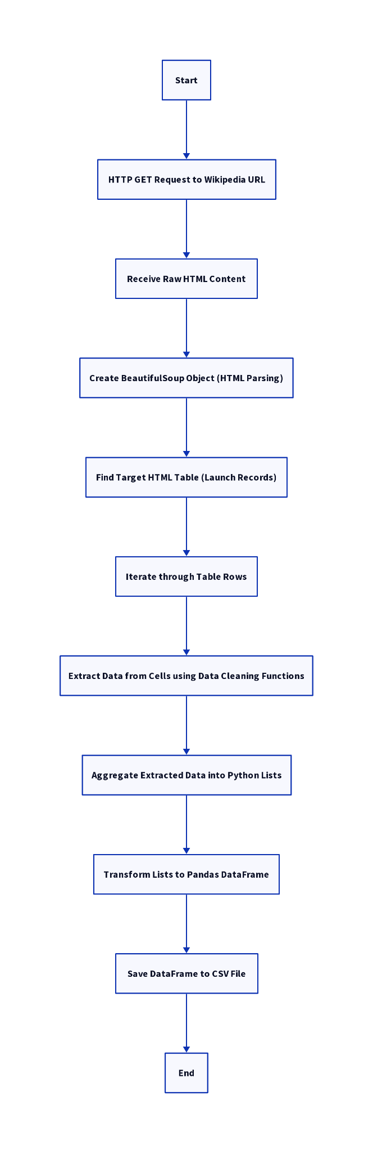
Data Collection - Scraping
https://github.com/Anusa123/Data-Science-Projects/blob/main/Capstone%20Projects/jupyter-labs-webscraping.ipynb

Slide 10
Data Wrangling
Cleaning
Converted complex landing outcomes into a binary classification target for machine learning models.
addressed missing values in critical featues using statistical imputation to maindata dataset integrity.
Applied one-hot encoding to categorical variables, expanding the feature space for algorithm compatibity.
https://github.com/Anusa123/Data-Science-Projects/blob/main/Capstone%20Projects/jupyter-labs-spacex-data-collection-api.ipynb
Imputation
Encoding
Scaling

Slide 11
EDA with Data Visualization
Scatter plots were used to see if there was any relationship between frequency of launces and weight of payload, distribution of launches across different sites and if certain launch sites are preferred for heavier payloads. Moreover bar chart was used to identify which orbits have the highest success rates and determine if the destination of the satellite impacts the landing probability of the first stage. Lastly, a line graph was used to visualise the launch success rate over time.
https://github.com/Anusa123/Data-Science-Projects/blob/main/Capstone%20Projects/edadataviz.ipynb

Slide 12
EDA with SQL
Identified 4 unique sites: CCAFS LC40, VAFB SLC4E, KSC LC 39A, CCAFS SLC40.
Calculated total NASA (CRS) payload mass 48,213 kg.
Found the successful ground landing date to be 2015-12-22.
Early ranking (2010-2017) shows ‘No attempt’ and ‘Success (drone ship) as dominant outcomes
https://github.com/Anusa123/Data-Science-Projects/blob/main/Capstone%20Projects/jupyter-labs-eda-sql-coursera_sqllite.ipynb

Slide 13
Build an Interactive Map with Folium
Markers: These represent specific geographic points on the map, often used to highlight locations with clickable popups and customizable icons.
Circles: These define a circular area around a specific coordinate, where the radius is measured in meters, making them ideal for visualizing zones or buffers.
Polylines: These are used to draw connected line segments—such as roads, flight paths, or boundaries—between a sequence of geographic coordinates.
Adding these three elements transforms a static background map into a functional data visualization tool
https://github.com/Anusa123/Data-Science-Projects/blob/main/Capstone%20Projects/lab_jupyter_launch_site_location.ipynb

Slide 14
Build a Dashboard with Plotly Dash
We included scatter plots, pie charts and a range to the dashboard with plotly dash.
Scatter plots, pie charts and a range were added in order to show relationships between 2 different items of interest for example payload size vs launch outcome.
https://github.com/Anusa123/Data-Science-Projects/tree/main/Capstone%20Projects/interactive%20dash%20with%20plotly

Slide 15
Predictive Analysis (Classification)
Build: I began by loading the dataset and creating a target variable Class (1 for a successful landing, 0 for failure). I used One-Hot Encoding to convert categorical variables into binary features and then standardized the data using StandardScaler to ensure all features contributed equally to the model.
Evaluate: I split the data into 80% training and 20% testing sets. I evaluated four classification algorithms: Logistic Regression, Support Vector Machine (SVM), Decision Tree, and K-Nearest Neighbors (KNN).
Improve: To optimize the models, I performed Hyperparameter Tuning using GridSearchCV with 10-fold cross-validation. This allowed me to find the most effective parameters to prevent overfitting and improve accuracy.
Find Best Model: I compared the models based on their Test Accuracy and Confusion Matrices. While all models performed similarly on the test set (approx. 83.33%), the Decision Tree often emerged as a preferred model in this specific lab context due to its slightly better handling of the specific feature set during cross-validation.
Key Phrases
Data Standardization: Scaled features to a mean of zero and unit variance.
Train/Test Split: Separated data to validate model performance on unseen data.
GridSearchCV: Automated the search for the best hyperparameters via cross-validation.
Confusion Matrix: Visualized True Positives, False Positives, and accuracy for each class.
Hyperparameter Tuning: Adjusted model settings (e.g., kernels, leaf sizes) for optimal fit
https://github.com/Anusa123/Data-Science-Projects/blob/main/Capstone%20Projects/SpaceX_Machine%20Learning%20Prediction_Part_5.ipynb

Slide 16
Results
1. Exploratory Data Analysis (EDA) Results
The EDA phase utilized both SQL and Python visualization (Matplotlib/Seaborn) to uncover patterns in the launch data:
Launch Success Trend: The success rate has significantly improved over time, specifically showing a sharp increase after 2013 and peaking between 2017–2020.
Launch Site Performance:
KSC LC-39A (Kennedy Space Center) has the highest overall success rate.
VAFB SLC-4E and CCAFS SLC-40 show higher failure rates for early flight numbers but improved as flight frequency increased.
Payload vs. Success: Higher payload masses (greater than 6,000 kg) show a slightly higher correlation with successful landings on certain orbits.
Orbit Success Rates: Orbits like ES-L1, GEO, HEO, and SSO achieved a 100% success rate in the analyzed dataset, whereas GTO orbit had a success rate of approximately 50% due to the complexity of the mission.
2. Interactive Analytics Demo (Dash & Folium)
The project included a dual-layered interactive component typically presented via screenshots in the final report:
Folium Interactive Map:
Markers: Red (failure) and Green (success) markers clustered around launch sites.
Distance Tool: Lines showing the distance of launch sites to geographical markers like coastlines, highways, and railways (noting that all sites are coastal to allow for over-water flight paths).
Plotly Dash Dashboard:
Dropdown Filter: Allows users to select specific launch sites.
Pie Charts: Displays the total success vs. failure ratio for the selected site.
Range Slider: Filters launches by Payload Mass (kg), updating a scatter plot to show the correlation between payload, booster version, and landing success.
3. Predictive Analysis Results
Four classification models were built and tuned using GridSearchCV and Decision trees performed at 88% accuracy better than other algorithms.

Slide 17

Section 2

Slide 18
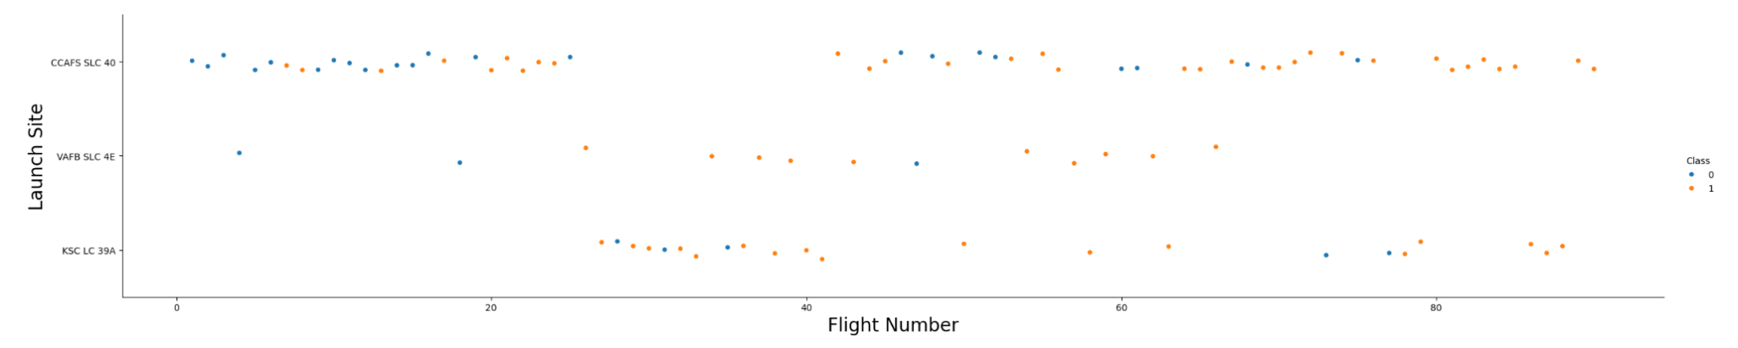
Flight Number vs. Launch Site
CCAFS SLC-40 is the most frequent launch site with a steadily growing success ratio over time.

Slide 19
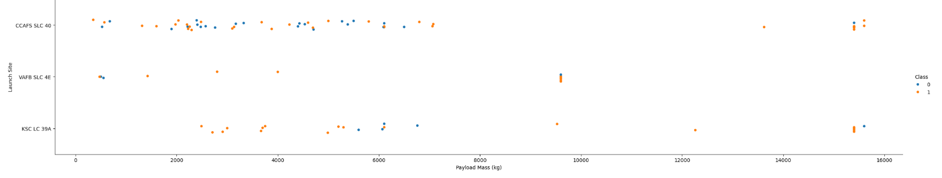
Payload vs. Launch Site
The VAFB-SLC launchsite shows there are no rockets launched for heavy payload mass(greater than 10000)

Slide 20
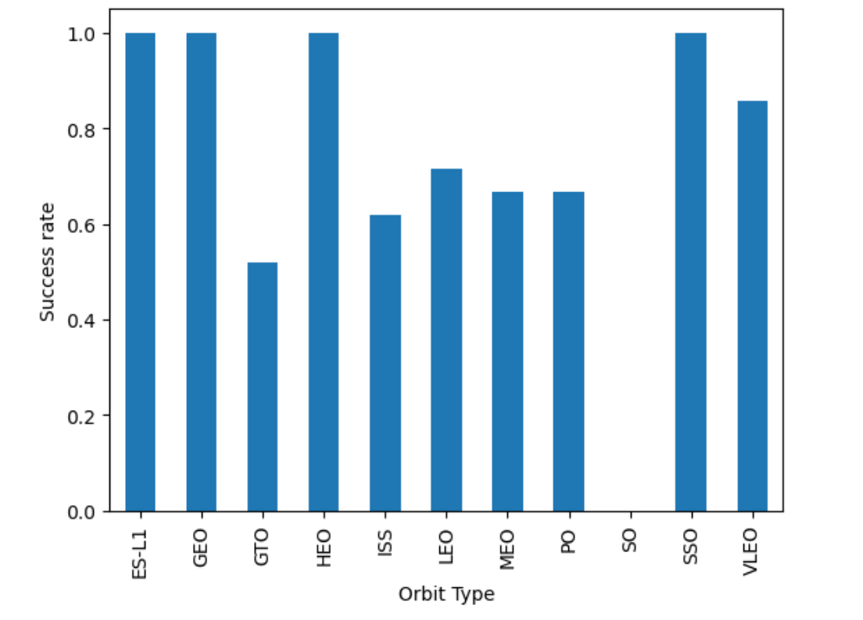
Success Rate vs. Orbit Type
Show a bar chart for the success rate of each orbit type
Show the screenshot of the scatter plot with explanations

Slide 21
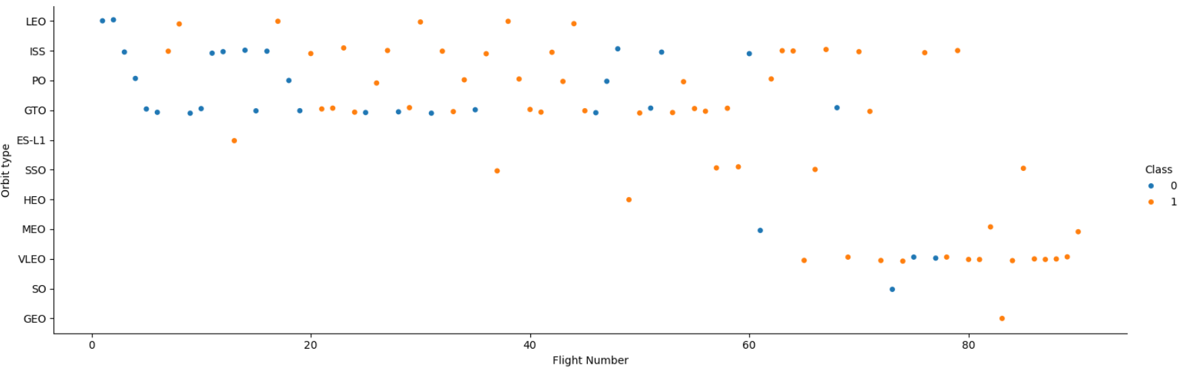
Flight Number vs. Orbit Type
Orbits like HEO, SSO, and GEO show a near-perfect success rates compared to GTO missions.

Slide 22
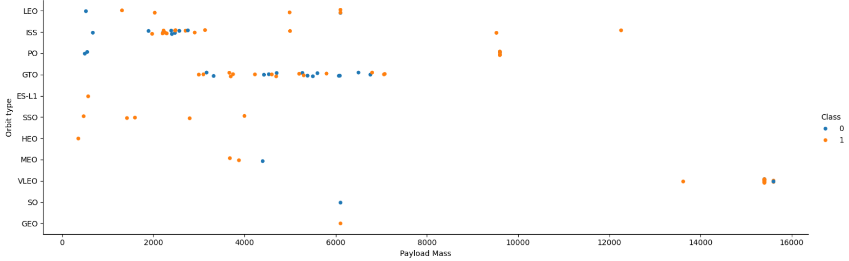
Payload vs. Orbit Type
Higher payload masses above 10 000kg are predominantly associated with VLEO orbits and have a high success rate, while performance in orbits like GTO is spread across a wider range of masses with mixed results.

Slide 23
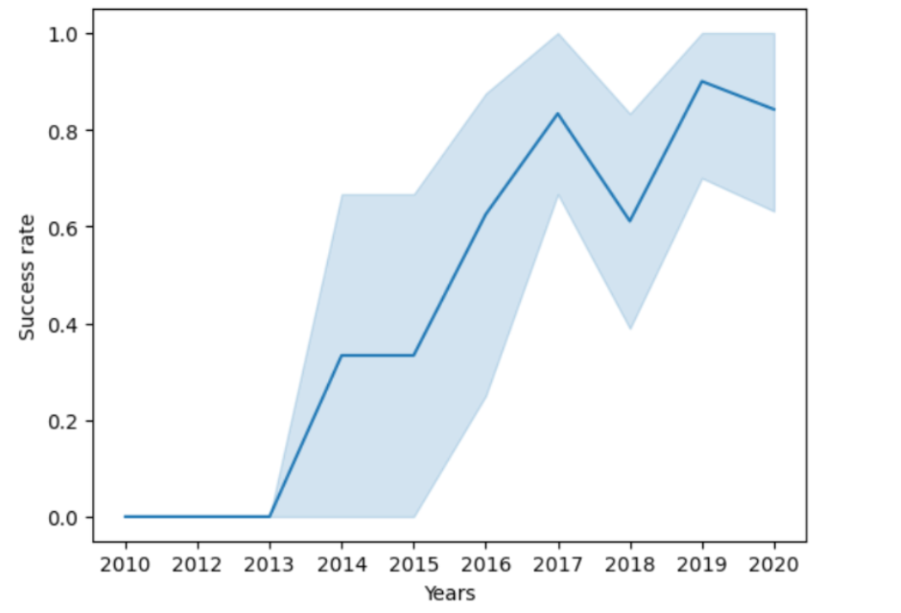
Launch Success Yearly Trend
The graph illustrates the launch success rate over time, showing a significant upward trend from 2013 through 2020.

Slide 24
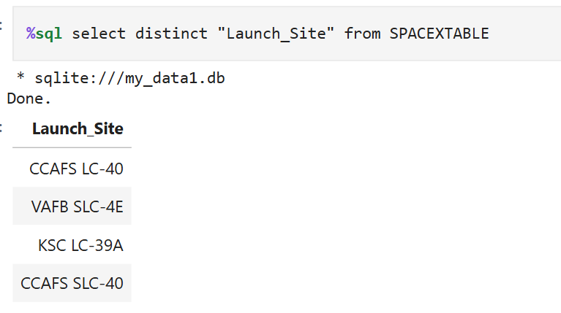
All Launch Site Names
There are four unique launch sites used as shown in the query result.

Slide 25
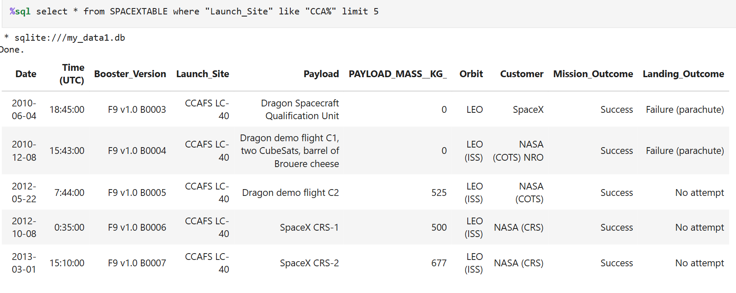
Launch Site Names Begin with 'CCA'
Above are 5 records where launch sites begin with `CCA`

Slide 26
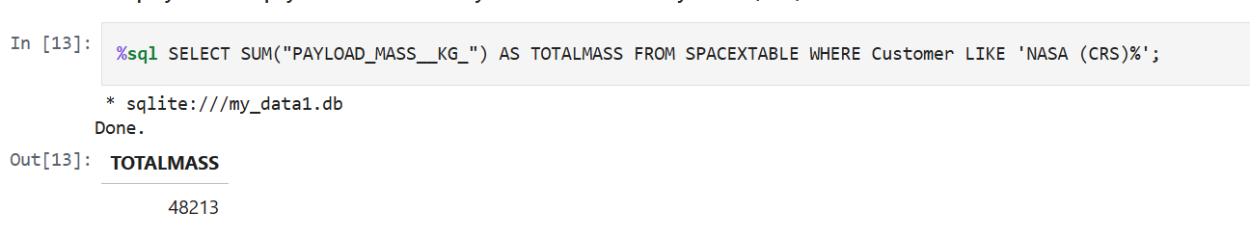
Total Payload Mass
The total payload carried by boosters from NASA is 48 213 KGs as shown by the query result above.

Slide 27
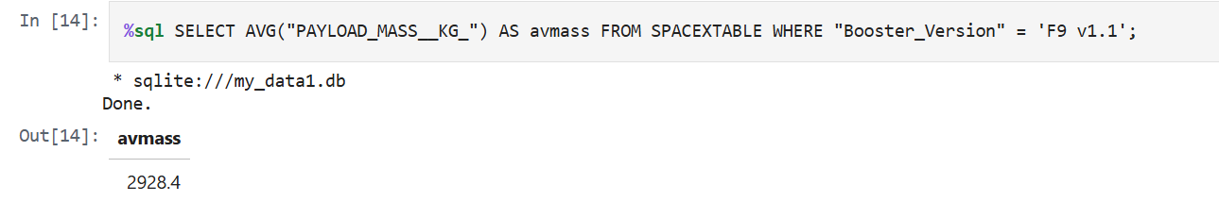
Average Payload Mass by F9 v1.1
The average payload mass carried by booster version F9 v1.1 is 2 928.4 KGs, shown by the query result above.

Slide 28
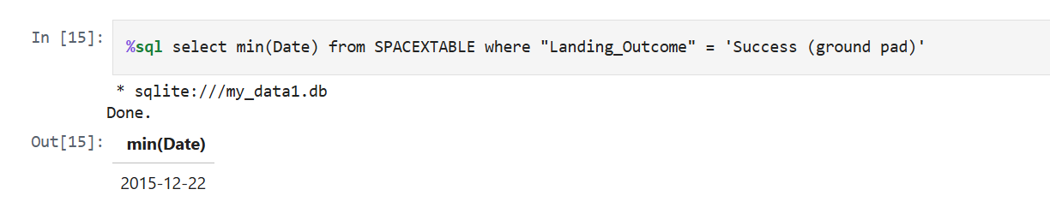
First Successful Ground Landing Date
The first successful landing outcome on ground pad took place on the 22nd of December 2015.

Slide 29
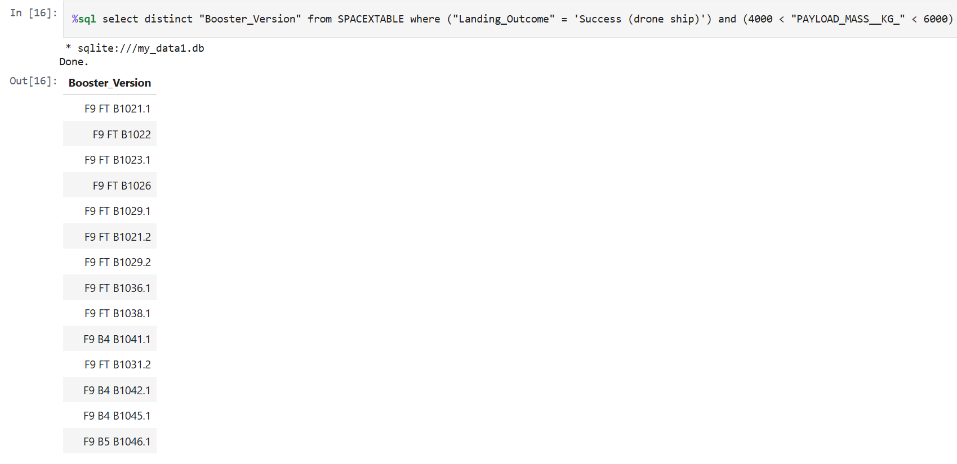
Successful Drone Ship Landing with Payload between 4000 and 6000
Above is a query result with a list of boosters which have successfully landed on drone ship and had payload mass greater than 4000 but less than 6000

Slide 30
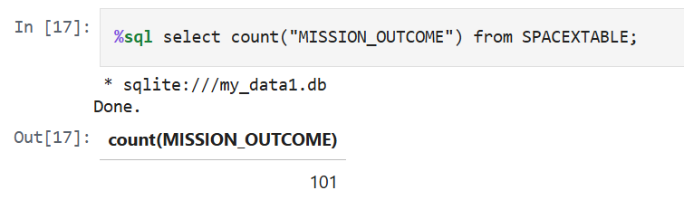
Total Number of Successful and Failure Mission Outcomes
The total number of successful and failure mission outcomes is 101.

Slide 31
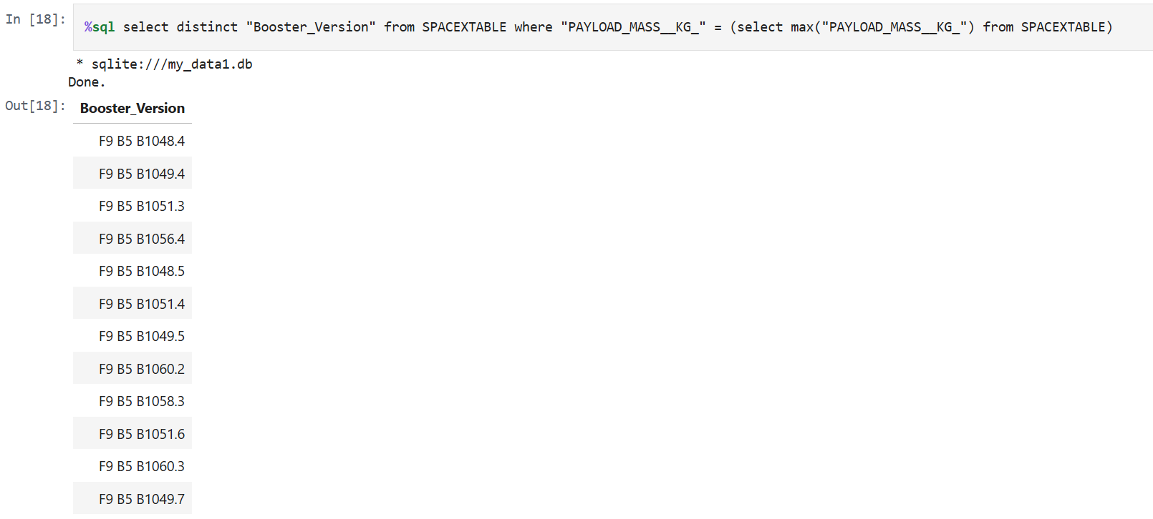
Boosters Carried Maximum Payload
There are 12 different boosters which have carried the maximum payload mass.

Slide 32
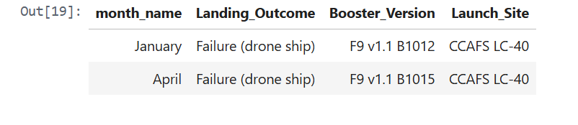
2015 Launch Records
They were 2 failed landing_outcomes in drone ship in January and April 2015 both of the same booster version and from the same launch site.

Slide 33
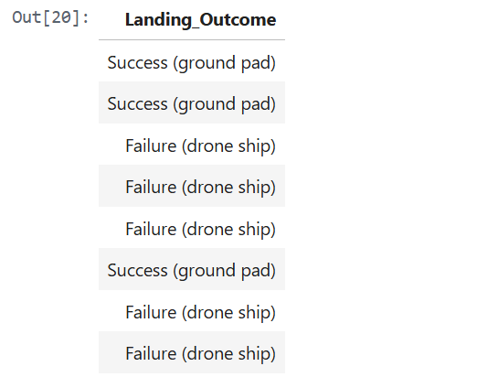
Rank Landing Outcomes Between 2010-06-04 and 2017-03-20
The landing outcomes shows that there we more Failure (drone ship) than Success (ground pad)) between the date 2010-06-04 and 2017-03-20.

Slide 34

Section 3

Slide 35
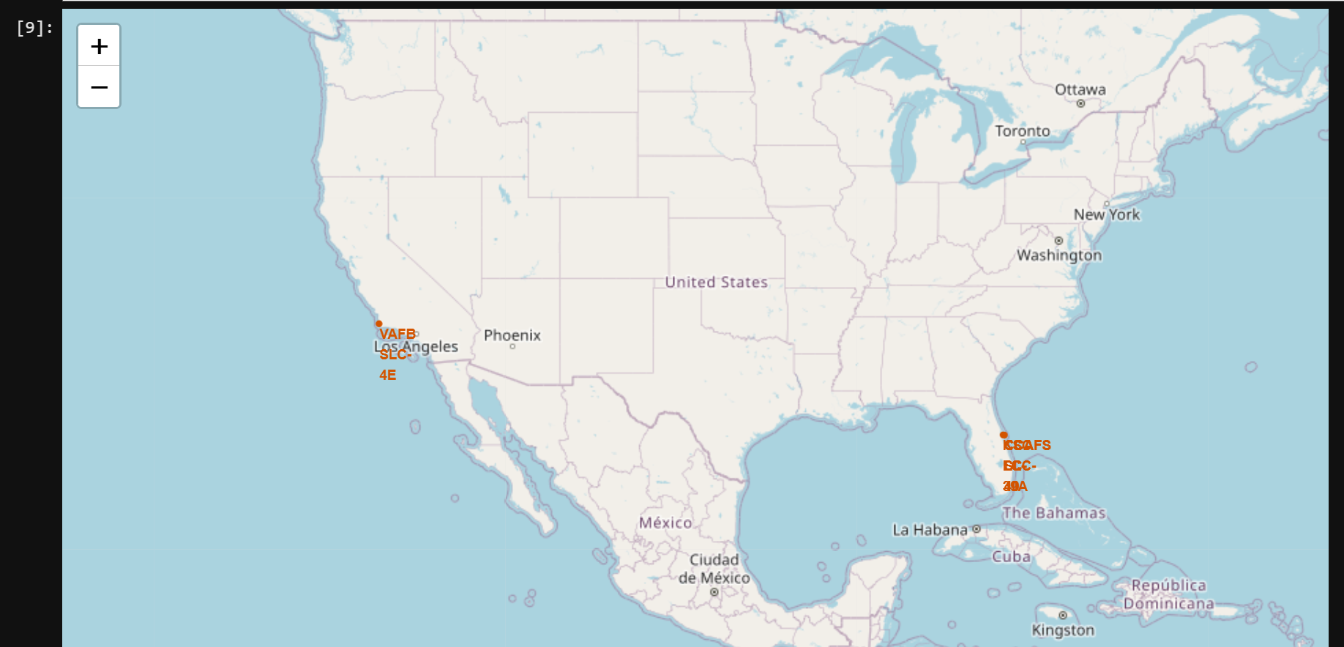
Spatial Proximity Analysis
Coastal Placements: All sites are located near coastlines to allow rockets to fly over the ocean, minimising risk to populated areas.
Transport Efficiency: Proximity to railways and highways is essential for the transport of massive rocket components.
Urban Distance: Launch sites are kept at a certain distance away from major cities to ensure public safety in case of failure.
Logistical efficiency and public safety are balanced through strategic site selection.

Slide 36
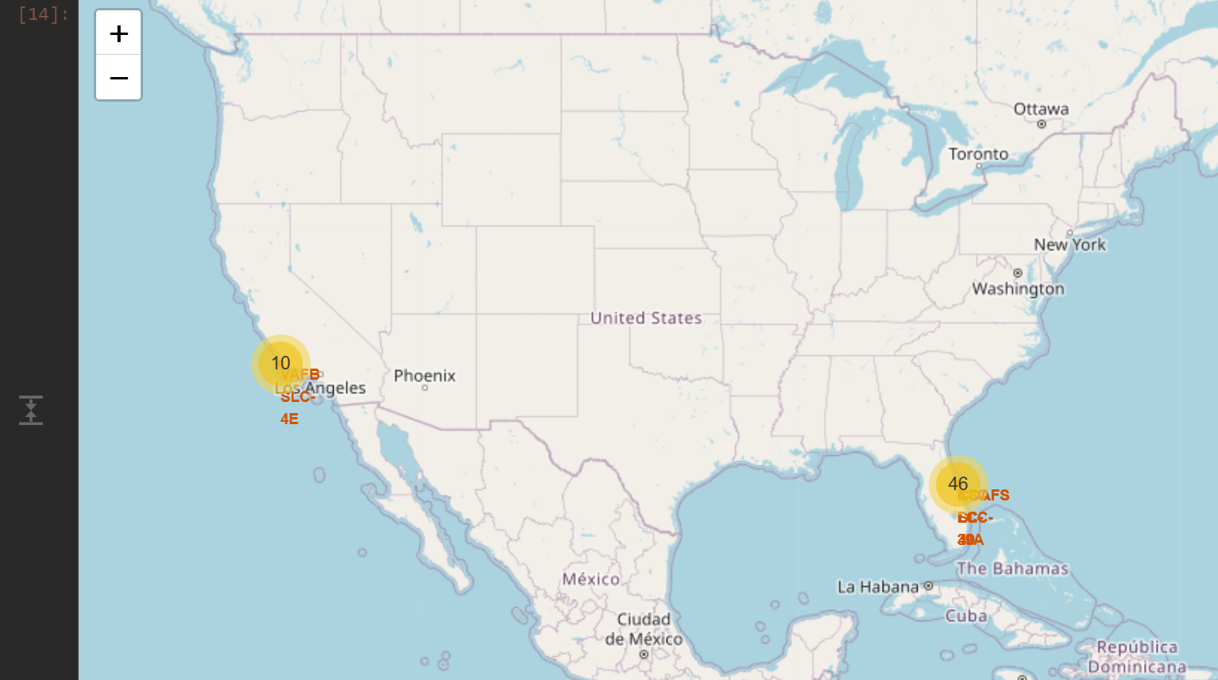
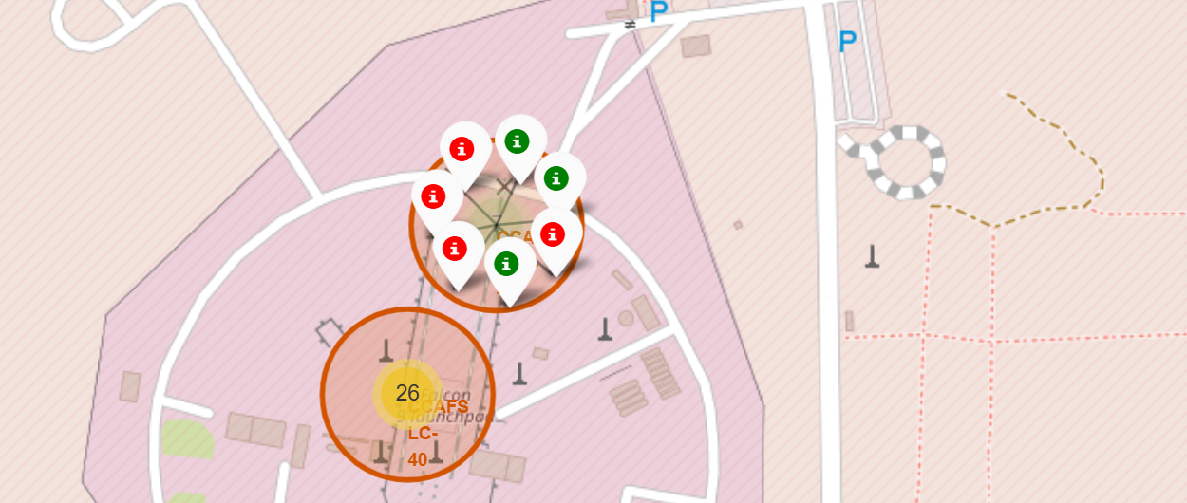
Launch Site CCAFS SLC-40
The folium map shows 2 successful launches on the CCAFS SLC launch site labeled green above.

Slide 37
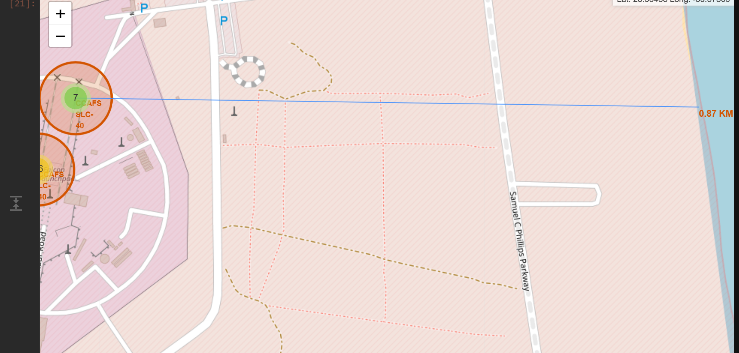
CCAFS Proximity to the Coastline
The generated folium map shows the launch site CCAFS SLC-40 to its proximities in the screenshot the coastline, with 0.87KM away from the launch site
Coastal Placements: The site is located near to the coastline to allow rockets to fly over the ocean, minimising risk to populated areas.

Slide 38

Section 4

Slide 39
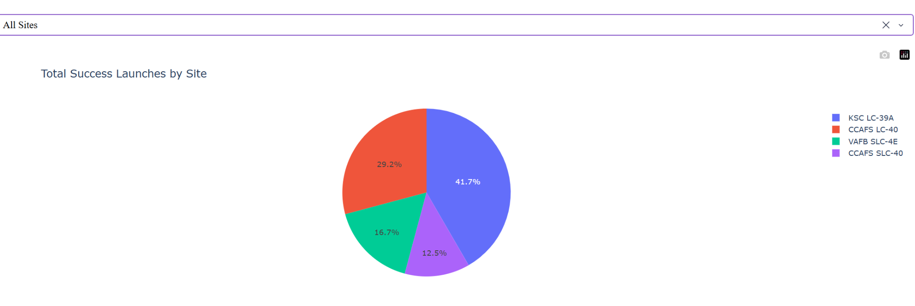
Launch success count for all sites
The screenshot shows total launch success count for all sites.
The screenshot shows that KSC LC-39A has the highest percentage of successful launches followed by CCAPS LC-40.

Slide 40
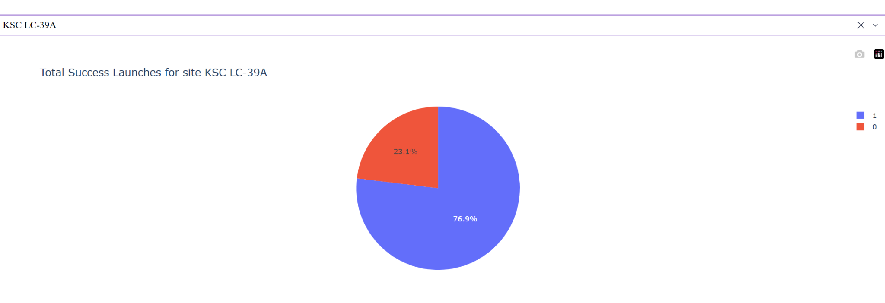
Highest launch success site
KSC LC-39A has the highest launches with 77% success rate .

Slide 41
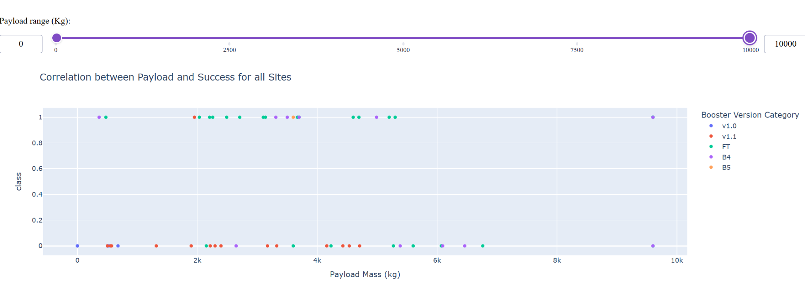
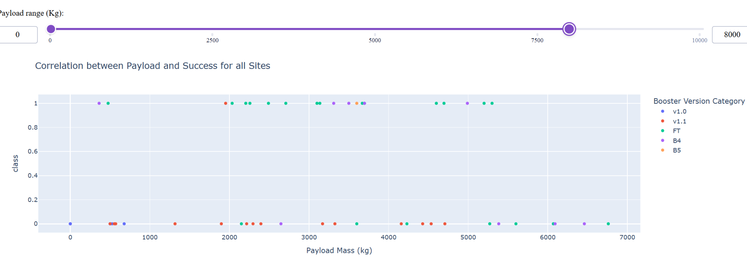
Scatter plot of Payload vs Launch Outcome
The analysis of the scatter plots reveals that while Payload Mass is a variable, the Booster Version is the primary driver of mission success.
Success Trends: The transition from early iterations like v1.0 and v1.1 to the FT and B5 versions shows a clear upward trajectory in reliability regardless of the payload weight.
Optimal Performance: The B5 booster stands out as the most robust version, maintaining a near-perfect success record across both low and high payload categories.
Operational Reliability: While heavier payloads (above 5,000 kg) were historically challenging, the data confirms that modern SpaceX hardware has effectively "de-risked" these missions, making launch outcomes more predictable for commercial and government clients..

Slide 42

Section 5

Slide 43
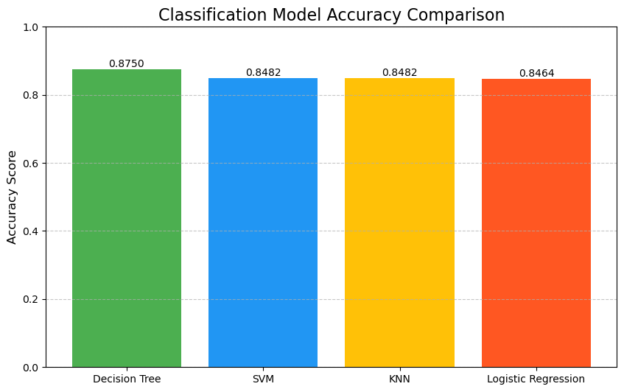
Classification Accuracy
Decision tree model has the highest classification accuracy of 87%.

Slide 44
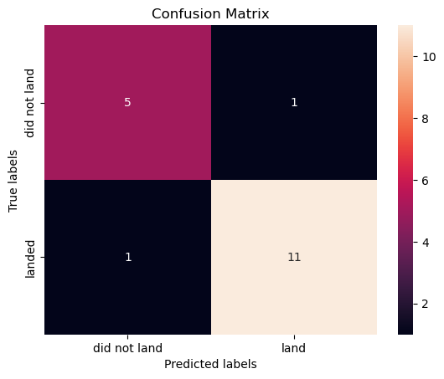
Confusion Matrix
The model is highly effective, achieving an overall accuracy of approximately 89% (16/18 correct predictions). It shows a strong ability to identify successful landings (High Recall) and rarely confuses one class for the other, suggesting it is well-tuned for this classification task.

Slide 45
Conclusions
Landing success can be predicted with over 87% accuracy using launch features.
Payload mass (3kg-7kg), recent booster versions (Block 5), and specific launch sites (KSC LC-39A) are the strongest predictors.
The yearly success trend confirms that SpaceX has successfully transitioned landing from an experiment to a routine operation

Slide 46
Appendix
SQL database used https://github.com/Anusa123/Data-Science-Projects/blob/main/Capstone%20Projects/my_data1.db
Predictive Analysis dataset https://github.com/Anusa123/Data-Science-Projects/blob/main/Capstone%20Projects/interactive%20dash%20with%20plotly/spacex_launch_dash.csv
Notebooks github link https://github.com/Anusa123/Data-Science-Projects/tree/main/Capstone%20Projects

Slide 47


